Slide 2
Timeline Company
Office of Private Sector Exchange Program Administration (OPA)
Teacher Sponsor Training

Slide 3
Organizational Chart
DEPUTY ASSISTANT SECRETARY FOR PRIVATE SECTOR EXCHANGE
POLICY & PROGRAM SUPPORT
OFFICE OF DESIGNATION
OFFICE OF PRIVATE SECTOR EXCHANGE PROGRAM ADMINISTRATION
OFFICE OF EXCHANGE COORDINATION & COMPLIANCE

Slide 4
Office of Designation
Roles and Responsibilities
DESIGNATIONS
OUTREACH
ALLOTMENT / EXPANSION
New sponsor applications, and redesignation of current sponsors.
Meetings with sponsors and stakeholders.
Requests for program forms and growth.
REPORTS
SEVIS
SSSP REGULATIONS
Collection and analysis of annual reports.
Updating sponsor information, reinstatements, etc.
Clarify regulations and Guidance Directives.
Notes:
OPA was established at the beginning of 2013 to absorb certain duties from the Office of Designation. This move was done to relieve the Office of Designation of a burgeoning workload and to increase monitoring of critical activities, with the paramount goal of ensuring participant health, safety, and well-being. OPA now assists in program monitoring, management, and resolution , while Designation focuses on program reviews and program requests from sponsors.
While OPA works closely with our colleagues in the Office of Designation, we do not have direct oversight of the designation and redesignation processes nor do we oversee visa administration (e.g. extensions or change of category requests). In brief, OPA:
Addresses participant issues, problems and complaints.
Monitors the toll-free hotline and responds to complaints and incidents that come in via jvisas@state.gov – both of these contacts are given to exchange visitors upon issuance of their J-1 visa at the U.S. embassy or consulate.
Conducts field visits to sponsors to evaluate special issues identified through internal reviews.
Organizes and carries out large program monitoring exercises
Provides recommendations for in-depth program investigations to the compliance office.
Let me provide you with some examples to provide more clarity. If an exchange visitor is found to be wrongfully terminated, Designation would be your point of contact for reinstating the record in SEVIS. Likewise, Designation will remain your contact for answering daily administrative and regulatory questions, submitting annual reports, pay.gov questions and processing redesignation applications.
You would contact OPA in case of an exchange visitor’s death or serious injury while on program. Another scenario might include a J-1 Professor or Scholar contacting OPA if they feel that their academic sponsor is not fully meeting the terms of their original contract. Additionally, OPA may reach out to your institution to inquire about academic training where exchange visitors appear to be in the United States primarily for work rather than academic study, a violation of EVP regulations.

Slide 5
Office of Private Sector Exchange Program Administration (OPA)
Roles and Responsibilities
INCIDENTS & COMPLAINTS
MONITORING
PROGRAM TRENDS
Investigating incidents and complaints received. Working with sponsors to resolve issues.
Monitoring the health, safety, and welfare of exchange visitors. Conduct routine and investigatory site visits.
Analyze incident and complaint data to identify areas of need.
PRESENTATIONS
BEST PRACTICES
REGULATIONS
Conferences and sponsor meetings.
Compile and share best practices.
Consult with sponsors on health, safety, and welfare regulations.

Slide 6
WHY REPORT INCIDENTS TO OPA?
1
2
3
PUBLIC DIPLOMACY OBJECTIVES
ASSISTANCE FROM THE DEPARTMENT
METRICS

Slide 7
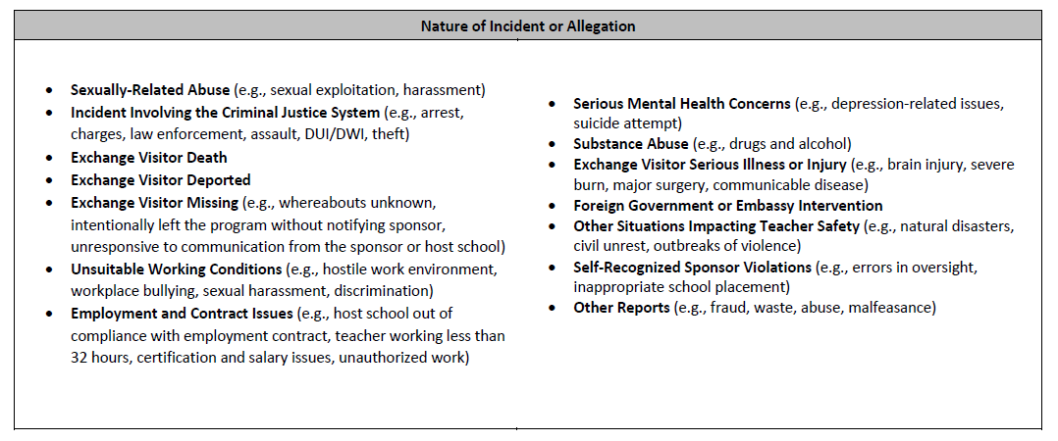
Incident Reporting Rubric
Report incidents on or before the next business day to Teacher_Physician@state.gov.

Slide 8
Incident Reporting
HOW TO REPORT:
Email: Teacher_Physician@state.gov
Include:
- Incident Report
An incident report is preferred in all situations, but a quick e-mail regarding an evolving situation, to be followed later by an incident report, is acceptable.

Slide 9
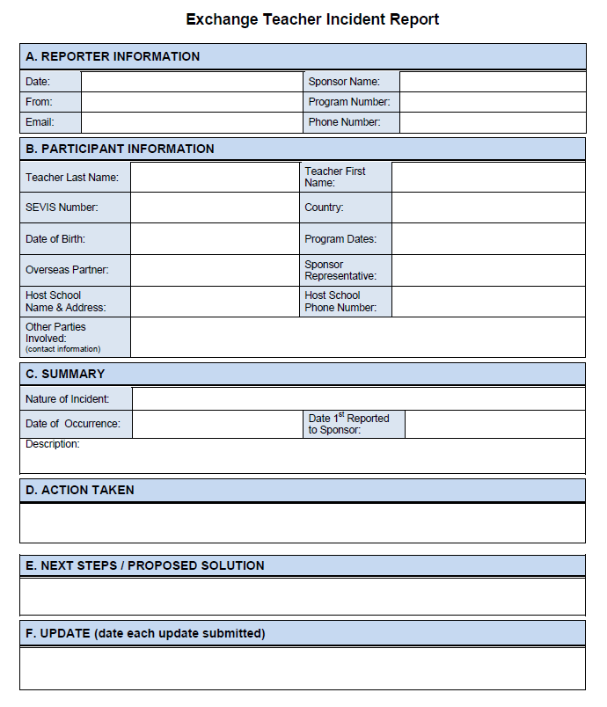
SAMPLE

Slide 10
What to Expect After Reporting an Incident to OPA
Sponsor reports incident
Case is logged into CMS
Analyst assesses case
Analyst responds to sponsor
Analyst works with relevant parties towards case closure
Case is closed
After providing OPA with an incident report, you will receive a reply from an OPA Analyst:
Asking for additional information
Asking for relevant documentation, including: - EV application - EV contract - Sponsor/Host Placement contract - Other program documentation
Request for updates, if warranted by situation (ex. EV commits crime and is charged)
Notes:
Incidents have ranged from the mistreatment of EVs to EV misbehavior. At times being unsure of when to report, sponsors have frequently erred in over- and under-reporting to us. This gives OPA-AG a very skewed view of the program and individual sponsor practices.
After considering these issues and consulting others, OPA-AG has produced a rubric that is designed to help sponsors know when to report. The following questions were presented by the NAFSA Ombuds in reaction to the OPA-AG Incident Reporting Rubric. The answers are intended to provide academic Exchange Visitor Program sponsors the background needed to know when, why, and how to report exchange visitor incidents to the Department.

Slide 11
Complaints:
Situations that are reported to OPA by anyone other than the sponsor.
Reported via hotline, general email address, or other means.
Once a complaint is received, it is processed much like an incident.

Slide 12
Best Practices
Ensure that each exchange visitor has a contract on file that has been signed by them, the sponsor, and the host school.
If the exchange visitor has a separate employment contract with their host school/district, ensure that you have a copy and that the terms are consistent with the program rules and regulations (both of the sponsor and 22 C.F.R. 62).
Ensure that the exchange visitor is aware of the sponsor rules that govern his/her exchange program, including : - Causes for termination; - Transfer procedures; - Who/how to contact someone with questions and concerns.
Ensure that placements do not only serve the needs of the host school/district, but also the exchange visitor.
Provide an orientation that includes information on the cultural difference surrounding school and teaching in the United States.
Educate the host placements on the unique situation and requirements of the exchange visitors.
Conduct periodic (e.g., monthly) check-ins with the exchange visitors on an individual basis to see how their program is going.

Slide 13
Monitoring Visits
After selecting a location, OPA will reach out to the sponsor(s).
If contacted, you will be asked to: - Confirm whether that location is the correct SOA. - Provide contact information for school/district.
On a visit, OPA may speak with: - Exchange Visitors - School District Representatives - School Administrators - Other Teachers
After each trip, OPA will reach out to sponsors to notify them of any areas of concern.

Slide 14
Contact Information
Office of Private Sector Exchange Administration
Mark Howard
Acting Branch Chief
Olga O’Neil
Program Analyst
Emmanuel Hector
Program Analyst (Detail)
Ethan Bursofsky
Program Analyst
Kyle Harrigan
Program Analyst
Teacher_Physician@state.gov
https://j1visa.state.gov/teacher-resource-page

Slide 15
Thank you!

